Slide 1
Agile Software Engineering
Introduction

Slide 2
The Beginnings
Software development, also known as software engineering, is defined by the Software Engineering Body of Knowledge (Abran, Moore, et al. 2004)
As a “systematic, disciplined, quantifiable approach to the development, operation, and maintenance of software, and the study of these approaches; that is, the application of engineering to software”.
Emerged in the 1950s with operating systems and became increasingly popular in the 1960s and 1970s as software became a focus in computing.

Slide 3
The Beginnings
The first, and still the most popular, software development process is referred to as the Waterfall model.
The Waterfall model advocates sequential phases of development in which each stage is completed before the next begins, with a focus on structure.
For example, all software designs are completed before the coding phase begins.
Despite the popularity of Waterfall development, it has continued to be criticized in the field for being process-heavy and unresponsive to the inevitable changes that arise during software development projects

Slide 4
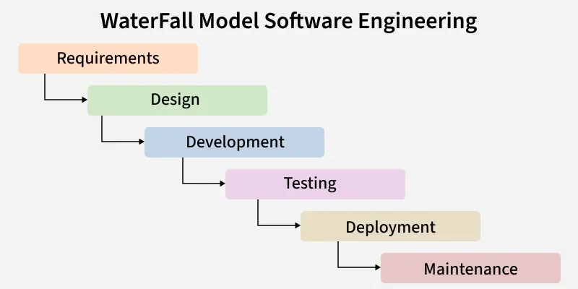
The Beginnings

Slide 5
The Beginnings
Features of the Waterfall Model
Sequential Approach:
  The waterfall model involves a sequential approach to software development, where each phase of the project is completed before moving on to the next one.
Document-Driven:
  The waterfall model depended on documentation to ensure that the project is well-defined and the project team is working towards a clear set of goals.
Quality Control:
  The waterfall model places a high emphasis on quality control and testing at each phase of the project, to ensure that the final product meets the requirements and expectations of the stakeholders.
Rigorous Planning:
  The waterfall model involves a careful planning process, where the project scope, timelines, and deliverables are carefully defined and monitored throughout the project lifecycle.

Slide 6
The Beginnings
Importance of the Waterfall Model
Clarity and Simplicity:
  The linear form of the Waterfall Model offers a simple and unambiguous foundation for project development.
Clearly Defined Phases:
  The Waterfall Model phases each have unique inputs and outputs, guaranteeing a planned development with obvious checkpoints.
Documentation:
  A focus on thorough documentation helps with software comprehension, maintenance, and future growth.
Stability in Requirements:
  Suitable for projects when the requirements are clear and stable, reducing modifications as the project progresses.
Resource Optimization:
  It encourages effective task-focused work without continuously changing contexts by allocating resources according to project phases.
Relevance for Small Projects:
  Economical for modest projects with simple specifications and minimal complexity.

Slide 7
The Beginnings
Advantages of the Waterfall Model
The classical waterfall model is an idealistic model for software development.
It is very simple, so it can be considered the basis for other software development life cycle models.
Easy to Understand:
  The Classical Waterfall Model is very simple and easy to understand.
Individual Processing:
  Phases in the Classical Waterfall model are processed one at a time.
Properly Defined:
  In the classical waterfall model, each stage in the model is clearly defined.
Clear Milestones:
  The classical Waterfall model has very clear and well-understood milestones.
Properly Documented:
  Processes, actions, and results are very well documented.
Reinforces Good Habits:
  The Classical Waterfall Model reinforces good habits like define-before-design and design-before-code.
Working:
  The Classical Waterfall Model works well for smaller projects and projects where requirements are well understood.

Slide 8
The Beginnings
Disadvantages of Waterfall Model
The Classical Waterfall Model suffers from various shortcomings we can’t use it in real projects, but we use other software development lifecycle models which are based on the classical waterfall model.
No Feedback Path:
  In the classical waterfall model evolution of software from one phase to another phase is like a waterfall.
  It assumes that no error is ever committed by developers during any phase. Therefore, it does not incorporate any mechanism for error correction.
Difficult to accommodate Change Requests:
  This model assumes that all the customer requirements can be completely and correctly defined at the beginning of the project, but the customer's requirements keep on changing with time.
  It is difficult to accommodate any change requests after the requirements specification phase is complete.
No Overlapping of Phases:
  This model recommends that a new phase can start only after the completion of the previous phase.
  But in real projects, this can't be maintained. To increase efficiency and reduce cost, phases may overlap.

Slide 9
The Beginnings
Disadvantages of Waterfall Model
Limited Flexibility:
  The Waterfall Model is a rigid and linear approach to software development, which means that it is not well-suited for projects with changing or uncertain requirements.
  Once a phase has been completed, it is difficult to make changes or go back to a previous phase.
Limited Stakeholder Involvement:
  The Waterfall Model is a structured and sequential approach, which means that stakeholders are typically involved in the early phases of the project (requirements gathering and analysis) but may not be involved in the later phases (implementation, testing, and deployment).

Slide 10
The Beginnings
Disadvantages of Waterfall Model
Late Defect Detection:
  In the Waterfall Model, testing is typically done toward the end of the development process.
  This means that defects may not be discovered until late in the development process, which can be expensive and time-consuming to fix.
Lengthy Development Cycle:
  The Waterfall Model can result in a lengthy development cycle, as each phase must be completed before moving on to the next.
  This can result in delays and increased costs if requirements change or new issues arise.

Slide 11
The Beginnings
When to Use Waterfall Model?
Well-understood Requirements:
  Before beginning development, there are precise, reliable, and thoroughly documented requirements available.
Very Little Changes Expected:
  During development, very little adjustments or expansions to the project's scope are anticipated.
Small to Medium-Sized Projects:
  Ideal for more manageable projects with a clear development path and little complexity.
Predictable:
  Projects that are predictable, low-risk, and able to be addressed early in the development life cycle are those that have known, controllable risks.

Slide 12
The Beginnings
When to Use Waterfall Model?
Regulatory Compliance is Critical:
  Circumstances in which paperwork is of utmost importance and stringent regulatory compliance is required.
Client Prefers a Linear and Sequential Approach:
  This situation describes the client's preference for a linear and sequential approach to project development.
Limited Resources:
  Projects with limited resources can benefit from a set-up strategy, which enables targeted resource allocation.
The Waterfall approach involves less user interaction in the product development process.
The product can only be shown to end user when it is ready.

Slide 13
The Beginnings
Applications of Waterfall Model
Large-scale Software Development Projects:
  The Waterfall Model is often used for large-scale software development projects, where a structured and sequential approach is necessary to ensure that the project is completed on time and within budget.
Safety-Critical Systems:
  The Waterfall Model is often used in the development of safety-critical systems, such as aerospace or medical systems, where the consequences of errors or defects can be severe.
Government and Defense Projects:
  The Waterfall Model is also commonly used in government and defense projects, where a rigorous and structured approach is necessary to ensure that the project meets all requirements and is delivered on time.
Projects with well-defined Requirements:
  The Waterfall Model is best suited for projects with well-defined requirements, as the sequential nature of the model requires a clear understanding of the project objectives and scope.
Projects with Stable Requirements:
  The Waterfall Model is also well-suited for projects with stable requirements, as the linear nature of the model does not allow for changes to be made once a phase has been completed.

Slide 14
The Rise of Agile Software Development
At the turn of the century, the world of technology became increasingly inundated with requests for new features.
This was particularly true for websites because society was becoming more dependent on Internet conveniences such as electronic mail, e-commerce, and real-time news updates.
Product development teams needed a new way to respond quickly to these demands to stay competitive in the changing market.
The solution came in the form of Agile development, validating assertions by Whiteside and Bennett that software development needs to become more of an iterative process (Whiteside, Bennett, et al. 1988).

Slide 15
The Rise of Agile Software Development
What is Agile development?
What comprises Agile development methodology, and
Why is it getting a reputation as the superior approach to the Waterfall methodology?

Slide 16
The Rise of Agile Software Development
Agile is an overarching term that includes iterative approaches to software development that embrace the values of the Manifesto for Agile Software Development.
Agile development methodologies are designed to stretch and support the needs of the project and organization.
Agile does not describe a specific approach, but instead offers a collection of tools and best practices that help development organizations focus on efficiency, collaboration, quality, and the creation of customer value.

Slide 17
The Rise of Agile Software Development
Agile development includes methodologies such as
Extreme Programming, Scrum, and the Crystal Family;
All of these versions of Agile development have their own nuances, but they share the goal of avoiding “a single pass sequential, document-driven, gated-step approach”.

Slide 18
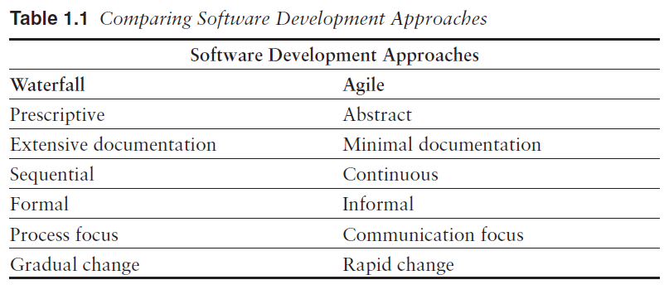
The Rise of Agile Software Development

Slide 19
The Agile Manifesto
The Manifesto for Agile Software Development (see Figure 1.1) was created in 2001 from a meeting of 17 practitioners who were interested in coming together in Snowbird, Utah, to discuss lightweight development methodologies.
Most of the participants came to discuss the various approaches they had either developed or used extensively.
The group formed the initial Agile Alliance group, whose mission was to promote a move to lighter development approaches and away from the heavy process of Waterfall development.
They were not interested in merging their lighter approaches, but instead worked to find an overarching term that accurately described all of the available lightweight approaches.

Slide 20
The Agile Manifesto
According to Williams and Cockburn (2003) and the practitioners who authored the Manifesto for Agile Software Development, Agile is a process for developing software that values
individuals and interactions over processes and tools, working software over comprehensive documentation, customer collaboration over contract negotiation, responding to change over following a plan.
  The practitioners were careful to use the term “over” in an effort to be less prescriptive and instead to make the manifesto more of a guide.
  They added the phrase “That is, while there is value in the items on the right, we value the items on the left more” to emphasize that there will be times when lighter approaches are not always realistic or possible, but they should always be the goal.

Slide 21
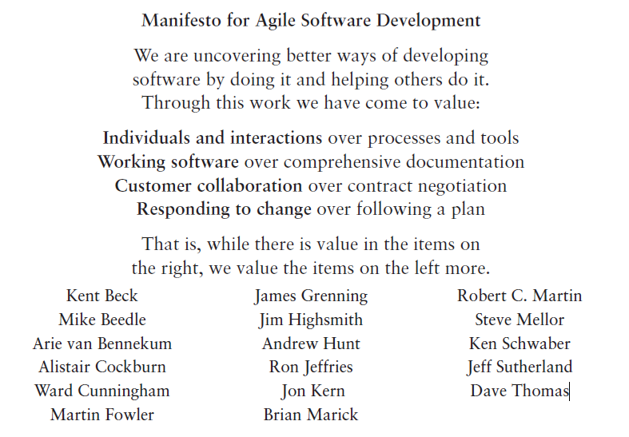
The Agile Manifesto

Slide 22
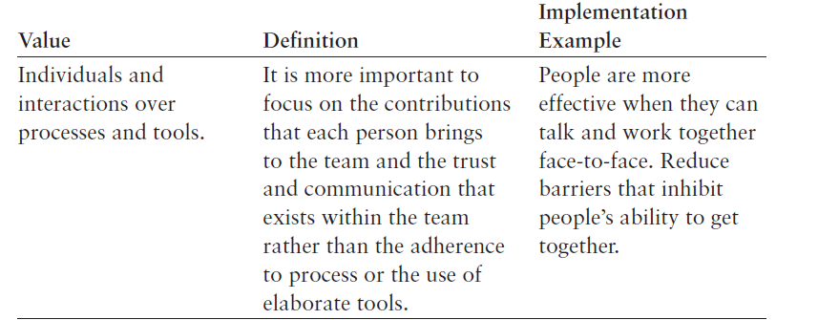
Agile Values Explained

Slide 23
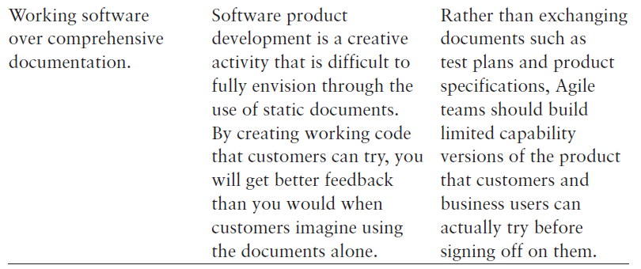
Agile Values Explained

Slide 24
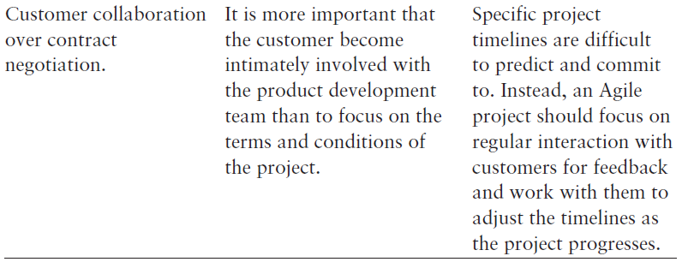
Agile Values Explained

Slide 25
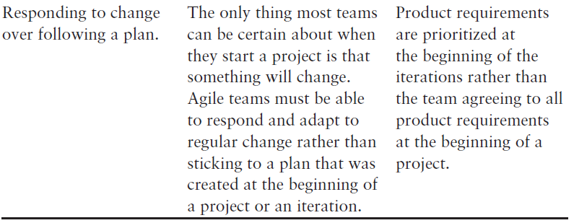
Agile Values Explained

Slide 26
After developing the list of initial values for Agile software development, the authors decided to add a list of principles that would help teams understand the priorities for Agile practices

Slide 27
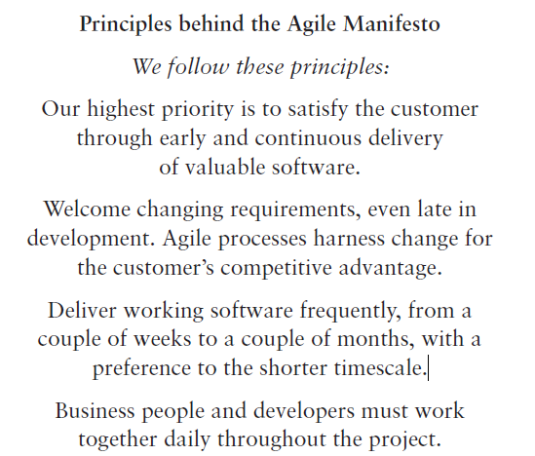
Principles behind the Agile Manifesto

Slide 28
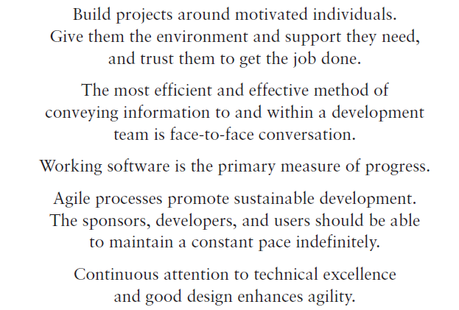
Principles behind the Agile Manifesto

Slide 29
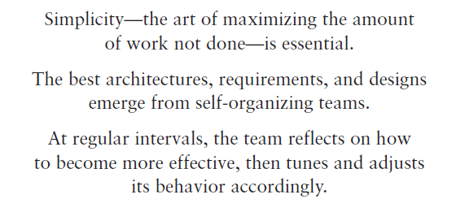
Principles behind the Agile Manifesto
  Each year, the Agile Alliance holds a major conference that covers a wide range of Agile topics.
  Attendance and participation in the conference have grown extensively each year as a result of the widespread adoption of Agile.

